Slide 1
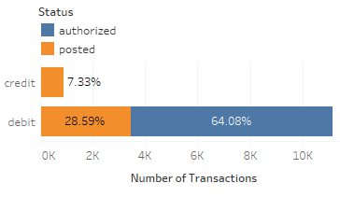
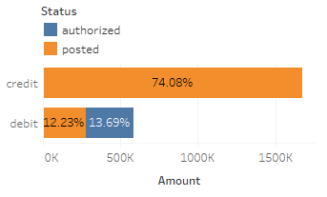
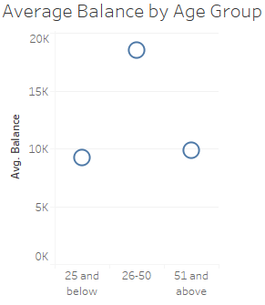
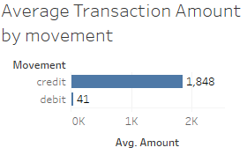
Key Insights about Transaction Dataset.
Fig 1.1
Fig 1.2
The dataset records 12043 transactions of 100 customers over 3 months(1st Aug 2018 – 31st Oct 2018).
All authorized(status) transactions are debit only and they have merchant information in them. Posted transactions don’t have merchant information.(Fig 1.1)
Total number of credit transactions dwarfs in comparison to debit transactions. But the average amount per credit transaction is very high.(Outliers are removed by 3 std deviations of amount) (Fig 1.2,1.4)
People aged between 26 and 50 have higher bank balance than other age groups. (Fig 1.3)
Fig 1.4
Fig 1.3

Slide 2
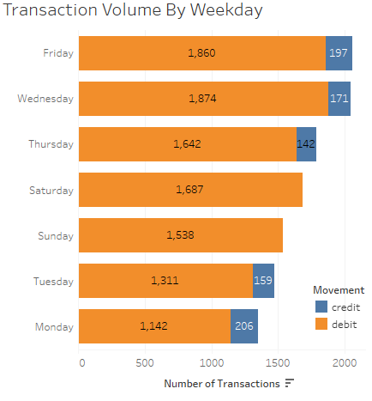
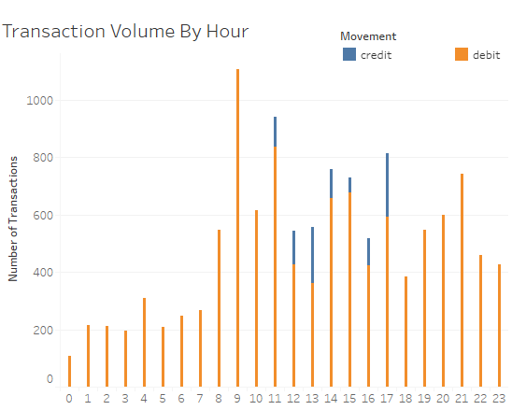
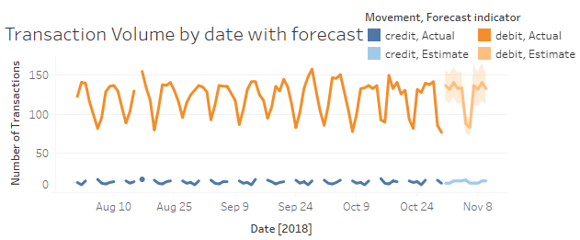
Key Insights about Transaction Volume.
The total number of transactions on a day follows a pattern, with most transactions taking place on Friday while least on Monday. There are no credit transactions on Saturday and Sunday.(Fig2.1,Fig 2.3)
Most number of transactions take place between 9am -10am. Transactions are at the lowest from 12 am to 7 am. (Fig 2.2)
16th August 2018 was the only day without any credit or debit transactions.(Fig 2.3)
Fig 2.2
Fig 2.1
Fig 2.3

Slide 3
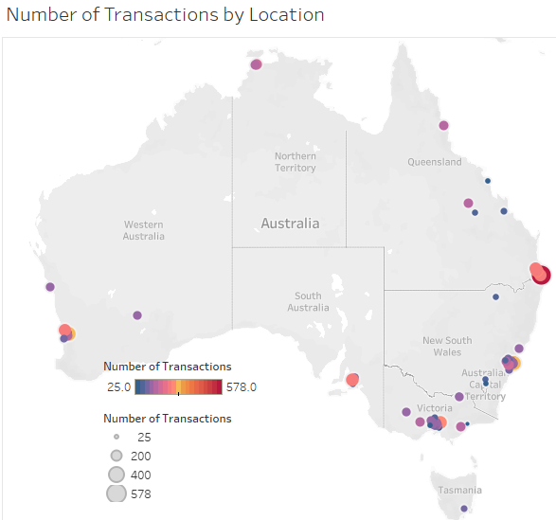
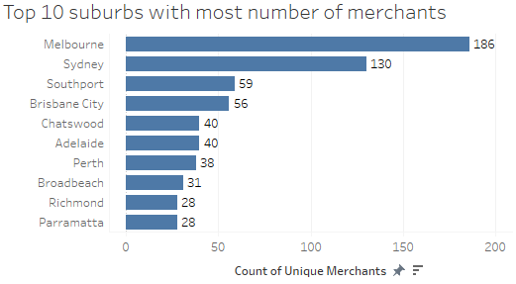
Key Insights about Transaction by Location
Most transactions take place on the south-east part of Australia. All Transactions from customer with id CUS-1617121891 have incorrect location.(Fig 3.1)
Most of the merchants are from the big suburbs like Melbourne and Sydney. (Fig 3.2)
Fig 3.2
Fig 3.1

